Slide 1
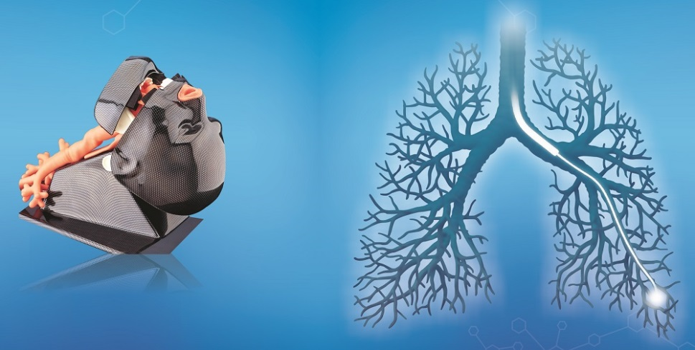
Introduction to Flexible Bronchoscopy (IFB) Course April 7 – 8 and May 6, 2107 Lima - Peru
Save The Date!!!
The 2017 IFB Course will be held in Lima – Peru. The educational program will have two parts:
- April 7 - 8 didactic conferences and Workshop 1: bronchoscopic anatomy and inspection (Step by Step).
- May 6 Workshop 2: Brushing and Bronchoscopic Biopsy with exam (BSTAT).
According to the Structured and Standardized curriculum of Bronchoscopy Education Project. (BEP).
Our team of nine certified bronchoscopy instructors by the World Association for Bronchology and Interventional Pulmonology (WABIP) will participate and support the learning program.
Av. Guardia Civil 270 Corpac, San Isidro – Lima 27, Perú
Peruvian Association for Bronchology (APBNI)
Conde La Monclova 350
San Isidro - Lima 27
Mail: apbni.peru@gmail.com
Notes:
Organizing Secretariat
APBNI
Conde La Moclova 350 San isidro Lima 27
Mail: apbni.peru@gmail.com

